Slide 1
Pattern Detection and Classifying

Slide 2

Background
According to the CDC:
Heart Disease is the leading cause of death in the US
Finding symptoms can be difficult
Can be dependent on one’s lifestyle

Slide 3
Dataset Used
Initial Dataset from CDC, surveying the American public.
Too vast to be optimal.
A preprocessed version of the same data found on Kaggle was chosen.

Slide 4

Problem
Use pattern detection and classification algorithms to predict the chances of getting a heart related disease given ones conditions

Slide 5
Preprocessing
Describing
Treating Variables
Sampling
Functions from SKLearn was used to visualize and clearly describe the chosen data.
Several encoding techniques from SKlearn was used to encode nominal and Ordinal data.
Numerical data was normalized.
Because the data was not balanced, Sampling Techniques was done to improve the final results.

Slide 6

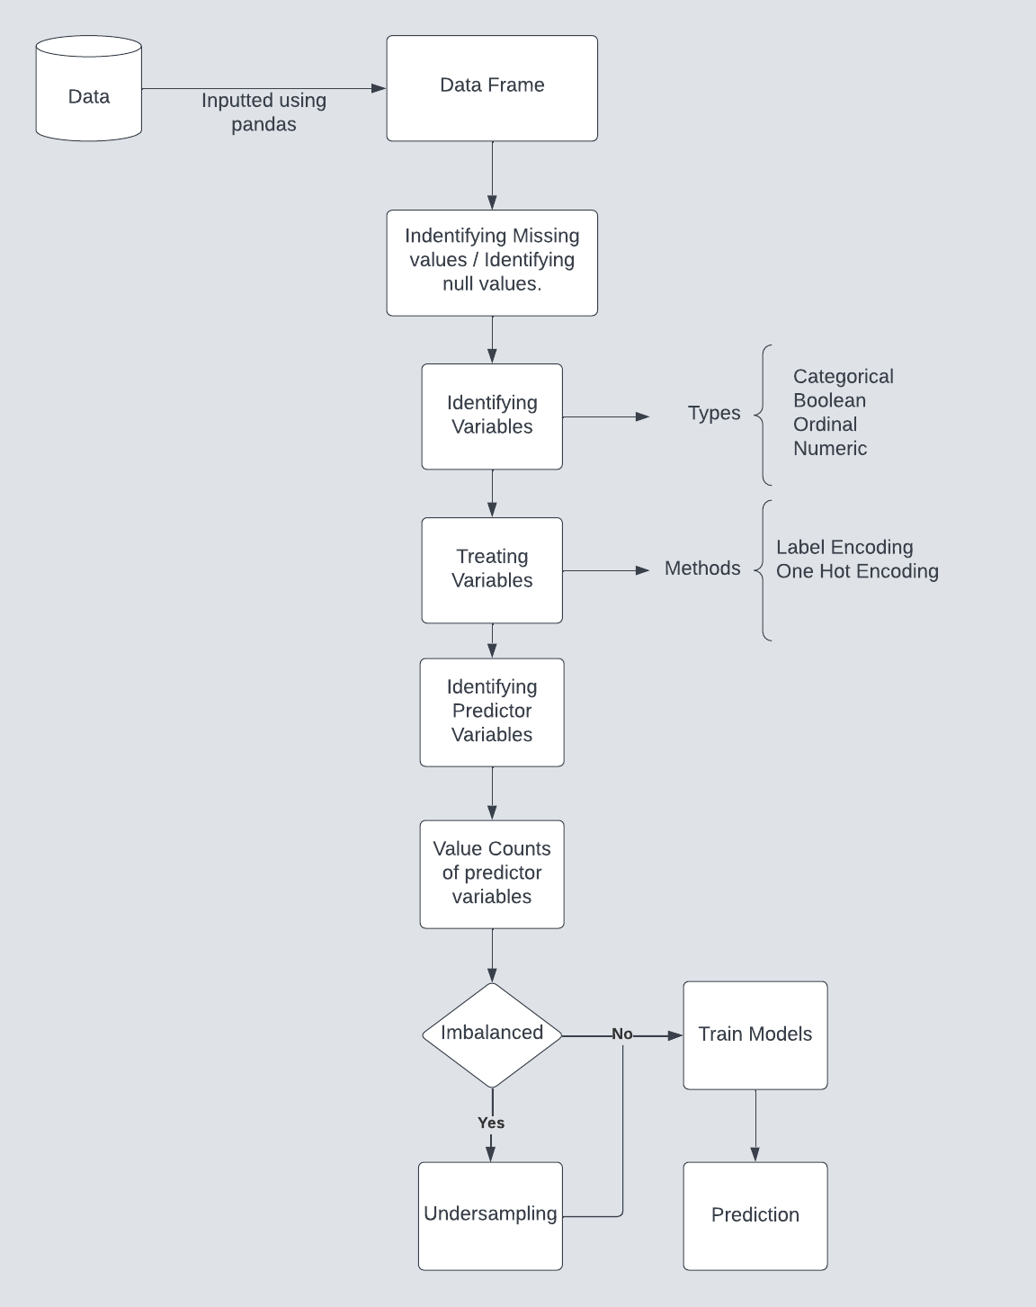
Flow chart

Slide 7
Logistic Regression
Logistic regression is a process of modeling the probability of a discrete outcome given an input variable.

Slide 8
It is used to understand the relationship between the dependent variable and one or more independent variables by estimating probabilities.
The most common logistic regression models a binary outcome.

Slide 9
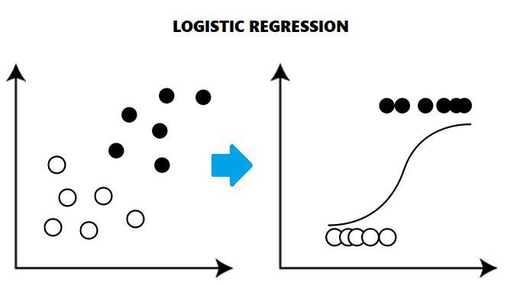
It is effective in handling the outliers compared to the linear regression model.

Slide 10
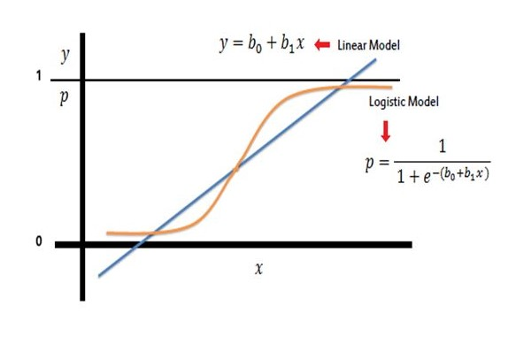

Slide 11
The precision values obtained using the logistic regression
 | Precision (Yes) | Precision (No)
Initial Dataset | 0.52 | 0.92
Preprocessed Dataset | 0.76 | 0.77

Slide 12
Decision tree
Decisions tree is popular in machine learning, due to its simple way of structuring it’s model.
Decision tree models require less data cleaning in comparison to other machine learning models.
Features are selected on nodes, based on the statistic measure like information gain

Slide 13
Decision tree:
Major drawback for decision tree is overfitting
Decision tree needs pruning to refine decision trees and overcome the potential of overfitting.
Prone to bias in machine learning models if the training dataset isn’t balanced or representative.

Slide 14
Decision tree
 | Precision (Yes) | Precision (No)
Initial Dataset | 0.55 | 0.92
Pre Processed Dataset | 0.76 | 0.7

Slide 15
Decision tree
 | Recall(Yes) | Recall(No)
Initial Dataset | 0.06 | 0.9
Pre Processed Dataset | 0.77 | 0.73

Slide 16
Random forest Algorithm
Random forest is identified as a collection of decision trees. Each tree estimates a classification, and this is called a “vote”. Ideally, we consider each vote from every tree and chose the most voted classification (Majority-Voting).​
Random Forests produce many unique trees.​

Slide 17
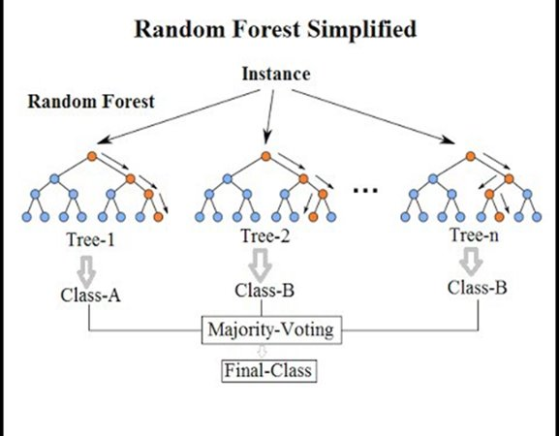

Slide 18
The precision values obtained using the Random Forest Classifier
 | Precision (Yes) | Precision (No)
Initial Dataset | 0.36 | 0.92
Preprocessed Dataset | 0.93 | 1

Slide 19
We have used Bagging technique to enhance the results of classification
 | Precision | Recall
Yes | 0.98 | 1
No | 1 | 0.98

Slide 20

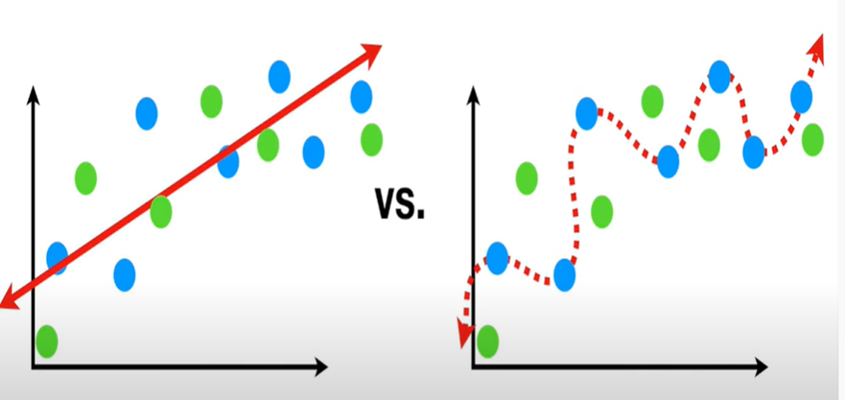
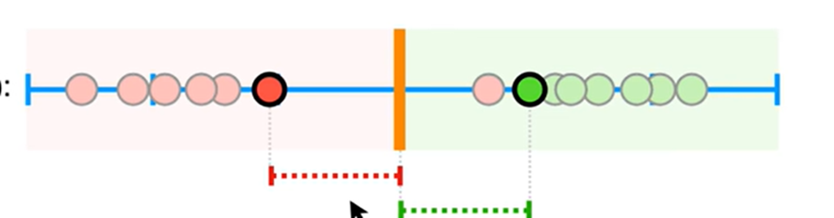
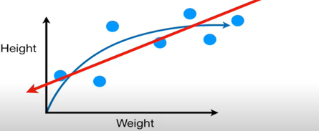
Support Vector Implementation
Bias : The Inability of model to capture true relationship
Variance: Difference in Fits on data
Soft Margin: The difference between observations and threshold
Various Kernels
Kernel Function
Images Referred from stat quest channel (youtube)

Slide 21
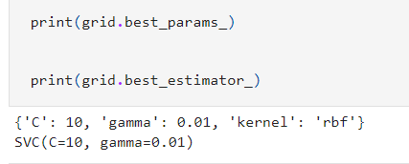
Support Vector Implementation
Test_train_split from sklearn was used to split data into test and training datasets.
Instance of sklearn.svm was created.
Fit train data into the classifier.
Measure the accuracy.
Undersampling used
Tune the Hyper parameters using Grid search CV
 | Precision (Yes) | Precision (No)
Initial Dataset | 0.64 | 0.92
Pre Processed Dataset | 0.76 | 0.79

Slide 22
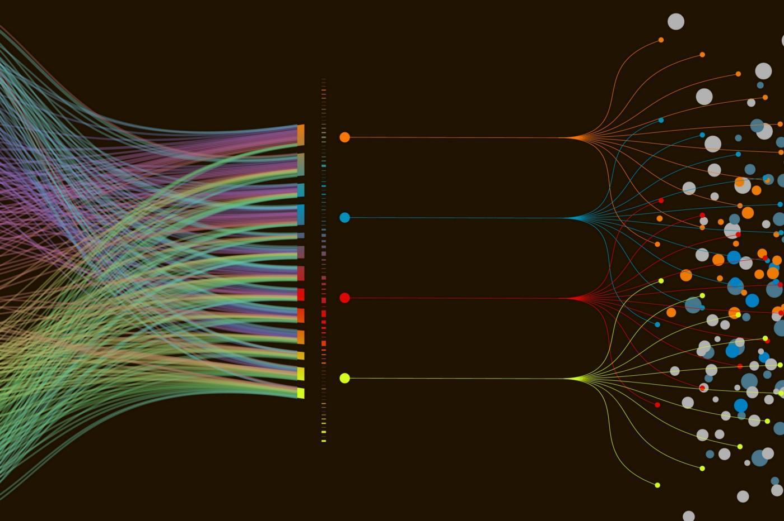
Naive Bayes
A simple probability classifying algorithm, based on the Bayes Theorem.
Find the probability of something (A) given than (B) has occurred.
Assumed that features are independent.
All features are considered to have equal weight.
Runs comparatively faster than other algorithms.

Slide 23
Naive Bayes Implementation
Test_train_split from sklearn was used to split data into test and training datasets.
Instance of gaussian naive bayes was created.
Fit train data into the classifier.
Measure the accuracy.
 | Precision (Yes) | Precision (No)
Initial Dataset | 0.26 | 0.95
Preprocessed Dataset | 0.77 | 0.67

Slide 24
Model | Accuracy | Precision for No(0) | Precision for Yes(1) | Recall for No(0) | Recall for Yes(1)
Logistic regression | 0.91 | 0.92 | 0.52 | 0.99 | 0.1
Decision tree | 0.91 | 0.92 | 0.55 | 1 | 0.06
Support Vector Machine | 0.92 | 0.92 | 0.64 | 1 | 0.02
Naive Bayes | 0.84 | 0.95 | 0.26 | 0.88 | 0.47
Random Forest | 0.91 | 0.92 | 0.36 | 0.98 | 0.12

Slide 25
Model | Accuracy | Precision No | Precision Yes | Recall No | Recall Yes
Logistic regression | 0.76 | 0.77 | 0.76 | 0.75 | 0.78
Decision tree | 0.75 | 0.76 | 0.74 | 0.73 | 0.77
Support Vector Machine | 0.77 | 0.79 | 0.76 | 0.75 | 0.80
Naive Bayes | 0.71 | 0.67 | 0.77 | 0.82 | 0.60
Random Forest | 0.96 | 1 | 0.93 | 0.93 | 1

Slide 26
Thank You

